Slide 1
Introduction
Chapter 1
Project Management
( Management Software Project)

Slide 2


What is a project?
everything done the first time is a project
can be constructing something
  road, building
can be organizing something
  a meeting, a movie

Slide 3
Project Definition
A project is a task, limited in time, to achieve a set of goals that require a concentrated effort
A project includes (attributes )
  Clear objective
  A set of deliverables to a client
  A schedule
  Technical and management activities required to produce and deliver the deliverables
  Resources consumed by the activities (people, budget)
  Sponsor or customer
  Degree of uncertainty

Slide 4
Project Definition
Focus of project management
  Administer the resources
  React to change
  Make sure, the goals are met.

Slide 5
Task
A task describes the smallest amount of work tracked by management
Typically 3-7 working days effort
Tasks descriptions
  Role
  Work product
  Start date
  Planned duration
  Required resources.

Slide 6
Role
A role defines a set responsibilities (“to-dos”)
Examples
Role: Tester
  Write tests
  Report failures
  Check if bug fixes address a specific failure
Role: System architect
  Ensure consistency in design decisions and define subsystem interfaces
  Formulate system integration strategy
Role: Connection
  Facilitate communication between two teams.

Slide 7
Work Products
A work product is a visible outcome of a task
Examples
  A document
  A review of a document
  A presentation
  A piece of code
  A test report
Work products delivered to the customer are called deliverables

Slide 8
Project Challenges
Because projects are new (not at the repetitive operations stage), they typically involve
  High levels of uncertainty and risk
  Difficult to estimate resources required
  Difficult to estimate time required

Slide 9
Scope of Complexity
amount of effort ( human)
number of groups and organizations to be coordinated
diversity in skills or expertise needed
Usually the MORE COMPLEX, the more time and resources required

Slide 10
Challenges of Modern Environments
rapidly changing technology
rising costs
increased competition.
frequent resource shortages.
many conflicting interest groups

Slide 11
Project Features
technological explosion
  286; 386; 486; Pentium; ?
  CASE tools; C++; GUI;
highly volatile & expanding market
  laptops; Internet, Oracle (Index-Organized Table (IOT))
Uncertainty
  how long will it take to program?
  will there be any bugs?
many people involved
  user group; systems designers; programmers; end users;

Slide 12
Project Manager Positions
Project Administrator / Coordinator
Assistant Project Manager
Project Manager / Program Manager
Executive Program Manager

Slide 13
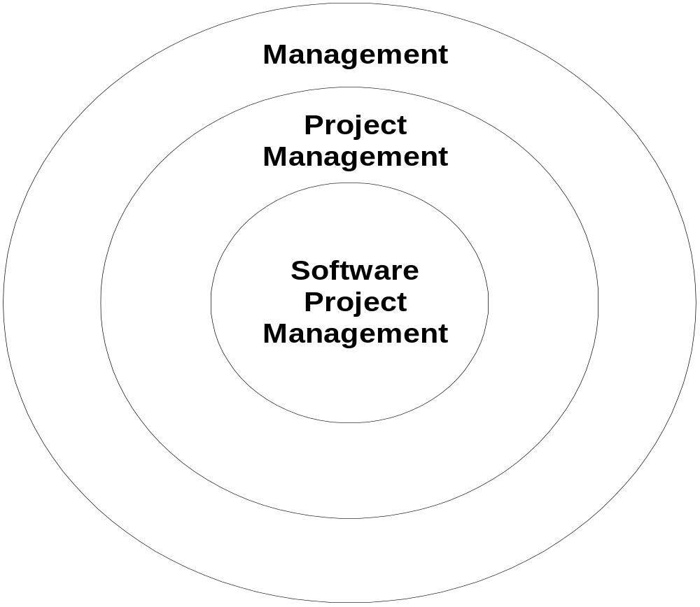
Software Project Management

Slide 14
Interactions / Stakeholders
As a PM, who do you interact with?
Project Stakeholders
  Project sponsor
  Executives
  Team
  Customers
  Contractors
  Functional managers

Slide 15
Project Constraints
Scope
Quality
Schedule
Budget
Resources
Risks
Customer satisfaction
Stakeholder support.

Slide 16
Scope
Project scope is all the work that must be done in order to produce all the project deliverables.
satisfy the customer that the deliverables meet the requirements or acceptance criteria.

Slide 17
Quality
Quality expectations must be defined from the onset of the project .
The project work scope must be done in a quality manner and meet specifications.

Slide 18
Schedule
The schedule for a project is the timetable that specifies when each activity (Task) should start and finish.

Slide 19
Budget
The budget of a project is the amount the sponsor or customer has agreed to pay for acceptable project deliverables.
The project budget is based on estimated costs associated with the quantities of various resources that will be used to perform the project.

Slide 20
Resources
Various resources are needed to perform the project activities, produce the project deliverables.
Resources include people, materials, equipment, facilities, and so forth.

Slide 21
Risks
Risks affect on accomplishing the project objective

Slide 22
Customer’s satisfaction
Completing the project scope within budget and on schedule or asking if the customer is satisfied at the end of the project

Slide 23
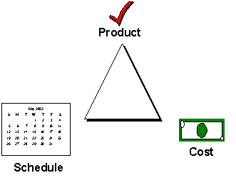
Trade-off Triangle

Slide 24
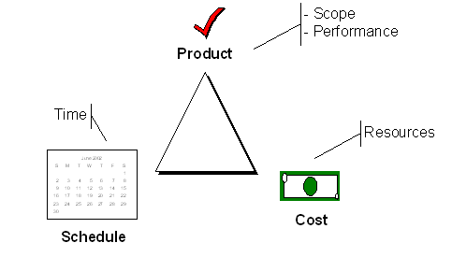
Trade-off Triangle
Know which of these are fixed & variable for every project

Slide 25
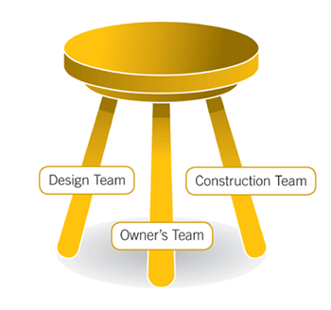
PM Three-Legged Stool
Project Success
Scope
Time
Cost
Notes:
Trade off requirements against time and cost. (if we make the house smaller it will cost less and take less time.)
Cannot exactly improve time by throwing in more money (diseconomies of scale). – overtime.
If the requirements increase, pretty soon the cost and time multiply exponentially and the stool is in danger of tipping over.

Slide 26
Project Manager Skills
Skills required:
  Analytical
  Technical
  Managerial
  Interpersonal

Slide 27
A. Analytical Skills
Four Sets of Analytical Skills:
  Project (Systems )Thinking
  Organizational Knowledge
  Problem Identification
  Problem Analyzing and Solving

Slide 28
1- Project (Systems) Thinking
A. Analytical Skills
  Ability to see things as systems:
  The ability to determine characteristics of a system, i.e think of systems in terms of: components (subsystems & their capacity), interrelationships, boundaries, interfaces, I/O, environment and constraints).
  Ability to translate physical things into abstract terms.

Slide 29
2- Organizational Knowledge
A. Analytical Skills
Must Understanding of how organizations work
Must Knowledge of specific functions and procedures of organization and department
  Terminology, abbreviations, forms, job description
Understand Internal policies
  key personnel, influence, etc.
Understand Competitive and regulatory environment
  Government Regulations and competitors
Understand the Organizational strategies
  Short/long term plans + Values & mission

Slide 30
3- Problem Identification
A. Analytical Skills
Problem is the difference between an existing situation and a desired situation.
Differences are defined by comparing the current situation to the output of a model that predicts what the output should be.
Then problem solving is to reduce the differences.
Identify the problem, analyze it (by knowing more), begin to formulate alternative solutions, choose best and put it for implementation
View problems as challenge and enjoy devising solutions.

Slide 31
4- Problem Analyzing and Solving (Simon’s Phases of Problem Solving)
A. Analytical Skills
Problem solving is to reduce the differences.
  Intelligence
    All relevant information is collected.
  Design
    Alternatives are formulated.
  Choice
    Best alternative solution is chosen.
  Implementation
    Solution is put into practice.

Slide 32
B. Technical Skills
Must understand the IT infrastructure:
Software, hardware and communication & networking.
  (Hardware capabilities: Network-computers, Microcomputers, Workstations, Minicomputers, Mainframes Super computers.)
  (Software experience: Prog.languages, OSs., DB_sys.
Sys._ development tools ( eg. Report generator, graphical interface, & design tools), Decision support systems and Data
Communication: Data comm., networking, and Internet

Slide 33
B. Technical Skills
Must be expert with different notations and methods for representing, or modeling various aspects of ISs.
Must keep up-to-date with technology (it is changing fast) How?
Read publications and books.
Join professional societies.
Attend workshops, shows, conferences & training.
Be on the Internet.

Slide 34
C. Management Skills
{Most times Leading a team or working with teams}
Four categories:
  Resource Management
  Project Management
  Risk Management
  Change Management

Slide 35
1- Resource Management
C. Management Skills
Manager needs to know how to get the most out of the resources of an organization, including team members.
Includes the following capabilities:
  Predicting resource usage
  Tracking resource consumption
  Using resources effectively
  Evaluation of resource quality
  Give up resources when no longer needed, and abandon them when they are out-of-date.

Slide 36
2- Project Management
C. Management Skills
Two Goals:
  Prevent projects from coming in late
  Prevent projects from going over budget
Assists management in keeping track of project’s progress
Consists of several steps:
  Decomposing project into independent tasks
  Determining relationships between tasks
  Assigning resources and personnel to tasks

Slide 37
3- Risk Management
C. Management Skills
Ability to anticipate what might go wrong in a project
Minimize risk and/or minimize damage that might result
4- Change Management
Introducing a new system into an organization is a change
Usually people don’t like change, and resist it
Manager must know how to get users to make smooth transition from current methods to a new IS. Freeze old ways, users must feel safe, motivation and competitive

Slide 38
D. Interpersonal Skills
Four types of skills:
  Communication skills
  Working with a team
  Facilitating groups
  Managing expectations

Slide 39
1- Communication Skills
D. Interpersonal Skills
Communication skills (most important), ability to communicate clearly and effectively with others (users, professionals and managers).
Effective communication helps to establish and maintain good working relationships with clients
Skills improve with experience

Slide 40
2- Working with a Team
D. Interpersonal Skills
Organize and manage your schedule, meet commitments and deadlines.
While working with teams, trust people when they talk based on their experience and accept their judgment.
Must understand the strengths & weaknesses of the other team members.
Must establish standard of cooperation and coordination

Slide 41
3- Facilitating Groups
D. Interpersonal Skills
Involves guiding a group without being a part of the group
Useful skill for sessions such as Joint Application Development (JAD) which demonstrates group interview where key people are set together to review matters and system requirements.
4- Managing Expectations
    Give a realistic picture of the new system
    Educate those who think down and ease those who think that the new system will perform miracles.

Slide 42
End of Presentation

